Slide 1
Skjellum’s Special Snowflakes
Austin Hancock (2nd year Masters, SWE)
Jeramy Lochner (Sophomore, SWE)
Matthew Rodgers (Sophomore, SWE)

Slide 2

Initial
Concept
Diagram

Slide 3
Noted
Concerns
And
Solutions
The API has a 1,000 calls per hour limit.
This was addressed by caching retrieved image urls resulting in a significantly reduced api calls.
Use of a text box to allow for date/sol queries.
Accepting user input as arguments for calls to a database can be a bit of a trust exercise. We opted for a zero-trust strategy and implemented checks on user input prior to it being accepted as arguments for querying.

Slide 4
Tech
Stack
Flask
SQLite / SQLAlchemy
Requests
HTML
CSS

Slide 5
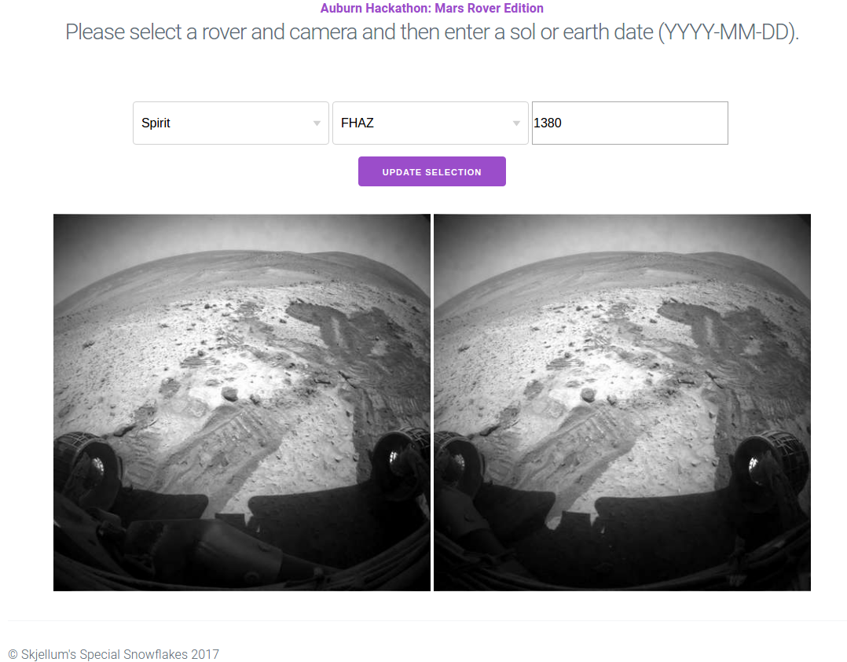
Final
Product

